Slide 1


Crash Course
Beyond The Basics
Presents
with
Abhijeet V Rajput

Slide 2
Spark components
Spark SQL
Structured data
Spark Streaming
Streaming data
MLIB
Machine learning
GraphX
Graph Computation
SparkR
R on Spark
Spark Core

Slide 3
Spark Application
Spark Driver
Cluster master, Mesos / Yarn
Cluster worker
Cluster worker
Cluster worker
EXECUTOR
CACHE
task
task
task

Slide 4
Spark SQL Application
Custonm application
. . . .
Reporting tools
JDBC/ODBC
Spark SQL Shell
Spark SQL
hive
JSON
Parquet
…..

Slide 5
Spark 2.0 application
Worker Node
EXECUTOR
CACHE
Spark
Session
task
task
task
Cluster manager
( YARN / MESOS ..)
Spark context
Worker Node
EXECUTOR
CACHE
task
task
task

Slide 6
Spark SQL
JDBC/ODBC
RPLB
Reporting tools
User programs
DataFrame API
Catalyst Optimizer
Resilient Distributed Datasets

Slide 7
Catalyst
Dataframe
SQL Query
Datasets
Unresolved Logical Plan
Catalyst
Logical Plan
Optimized Logical Plan
Physical Plans
Physical Plans
Physical Plans
Cost models
Selected Physical Plans

Slide 8
Spark Applications
RDD
2
transformations
Partition #
1
transformations
Partition #
Action
transformations
Partition #
actions
Stage 1
JOB
5
3
actions
Stage 1
Partition #
Task #
Partition #
Task #
4
Partition #
Task #

Slide 9
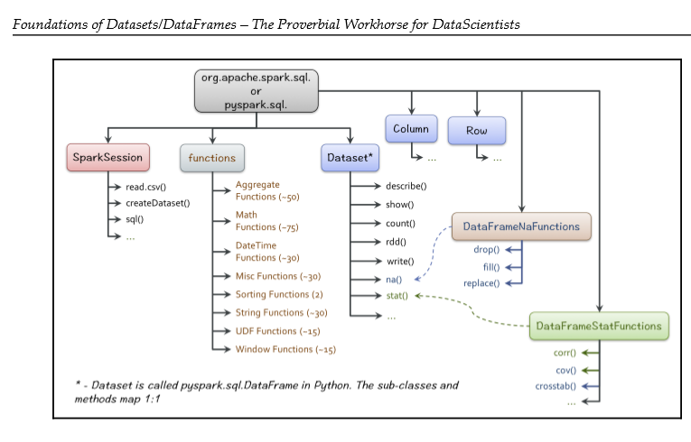
Spark for ETL

Slide 10
To be deleted
Pyspark.sql
Columns
ROW
Spark session
Functions
Datasets/frames

Slide 11
Spark SQL ( basics )
Spark’s interface for working with structured and semi structured data.
Load variety of data sources like JSON, HIVE, Parquet, JDBC/ODBC, CSV and many 3rd party connectors.
Spark SQL Abstraction on RDD, makes code much smaller
DataFrame API DataFrame is a distributed collection of rows with a homogeneous schema
Spark SQL supports accessing data using standard SQL queries and HiveQL, a SQL-like query language that Hive uses. In this chapter, we will explore different features of Spark SQL. It supports a subset of HiveQL as well as a subset of SQL 92. It runs SQL/HiveQL queries alongside, or replacing the existing Hive deploymen
SupportsSchema Inference for Semi structured Data
Apache Spark is a general-purpose cluster computing engine with APIs in Scala, Java and Python and libraries for streaming, graph processing and machine learn
Support Relational Processing both within Spark programs and on external data sources Provide High Performance using established DBMS techniques.

Slide 12
DataFrame API
DataFrame is a distributed collection of rows with a homogeneous schema
Apart from these, there are so many other external data sources supported through thirdparty
packages:
JSON
Parquet
Hive
MySQL
PostgreSQL
HDFS
Plain Text
Amazon S3
ORC
JDBC

Slide 13
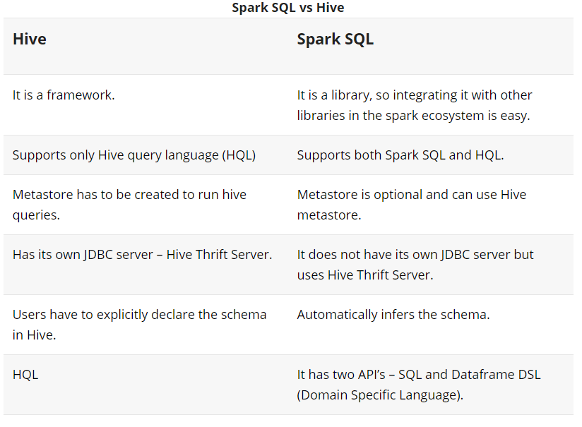

Slide 14
HiveContext &SQLContext
Spark SQL Application must create instance of the SQLContext or HiveContext class
HiveContext provides a superset of the functionality provided by SQLContext. The parser that comes with HiveContext is more powerful than the SQLContext parser. It can execute both HiveQL and SQL queries.
Hive Context is required to implement Window functions and accessing hive UDF, but Spark 2.0 provides native window functions
HiveContext is required to start Thrift server.
Pyspark.sql
SQLContext
HiveContext

